Slide 1




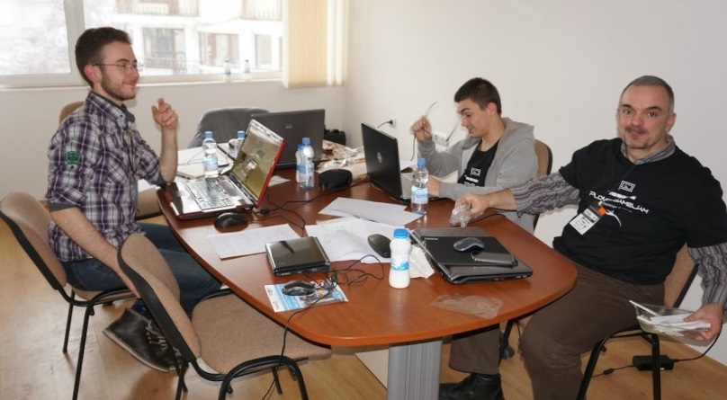
Teamwork and Personal Skills
Course Introduction
Teamwork and
Personal Skills
SoftUni Team
Technical Trainers
Software University
http://softuni.bg

Slide 2



Table of Contents
Course Objectives
Course Program
Trainers Team
Assessment
Learning Resources

Slide 3










SoftUni Diamond Partners

Slide 4



Course Objectives & Program
What Topics Shall We Cover?

Slide 5

The Course Objectives
Teamwork and Personal Skills course goals
Get along in preset teams of 3-7 people
Learn to enjoy collaborating with others
Learn to work on real-world practical projects
Develop a culture of open sharing of knowledge
Help SoftUni to grow and operate its free trainings
Promote the free trainings / assist in teaching

Slide 6

Course Benefits
Benefits from the course
Adopt the open knowledge culture
Build your own blog
Your blog is more than online CV!
Build your own public developer profile (at GitHub / Google Code / CodePlex)
Get teamwork experience
On real-world projects, in real teams
Learn how to learn: mind mapping, speed reading, etc.

Slide 7
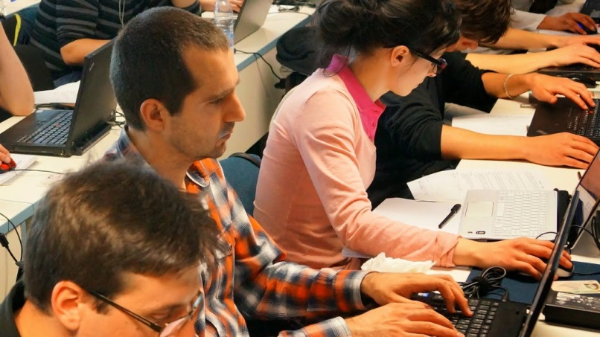

Course Program
Course Intro
Source Control Systems: Git, SVN, TFS
Project Tracking Tools: Trello, BaseCamp, …
Start Your Own Blog
Teambuilding
Writing a CV and Cover Letter
Finding and Successfully Going Through Interview
Mind Mapping
Speed Reading and Efficient Study Techniques
Student Visiting Hours

Slide 8
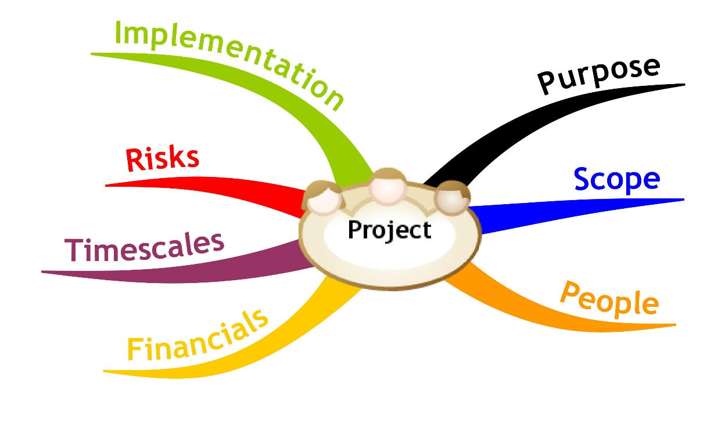
Teamwork Projects @ SoftUni
Application Process, Teamwork Process, Examples

Slide 9

Teamwork Projects: The Process
The process of working on the team projects:
Students sign-up for a teamwork
The system splits the students in teams
The trainers assign a teamwork project
The students find each other and begin work
Students work on their projects
Assign tasks, collaborate, communicate, perform meetings, write code and documents, merge the results, etc.
Perform a public defense (presentation)
Asses each team member and give feedback

Slide 10

Sample Teamwork Projects
Write a Wikipedia article about programming
E.g. "sorting algorithms", "GitHub", "C#"
Write a console-based game
E.g. Snake / Tetris / Minesweeper / Falling Rocks
Create a web site
E.g. a site for fun stories / fun images
Create a JavaScript web-based game
E.g. Tetris / Falling Rocks / Xonix

Slide 11

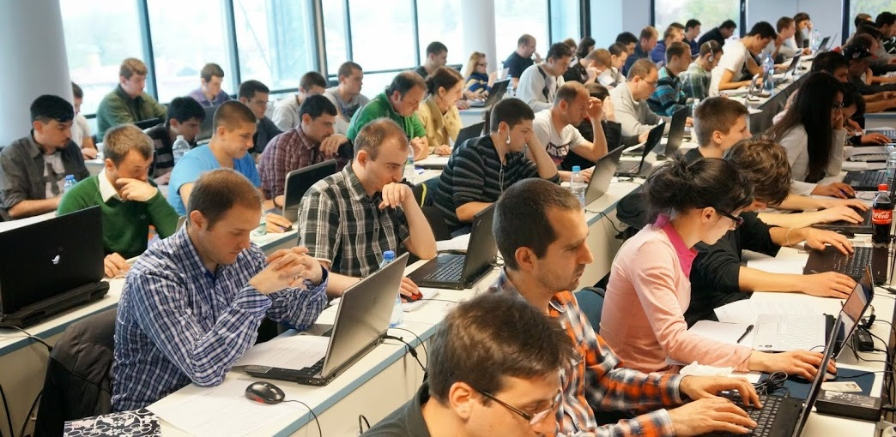

Assessment
Assessment Criteria

Slide 12


Assessment
Homework – 50%
Teamwork Project – 50%
Bonuses – up to 10%
Presence in class – 5% (onsite students only)
Forum – 5%

Slide 13








Resources
What We Need in Addition to This Course Content?

Slide 14
Course Web Site & Forums
Register for the "SoftUni Forum":
Discuss the course exercises with your colleagues
Find solutions and assistance for the exercises
Share source work / discuss ideas
The course official web site:
https://softuni.bg/forum/
https://softuni.bg/courses/teamwork-and-personal-skills/

Slide 15
TWPS – Course Introduction
https://softuni.bg/courses/teamwork-and-personal-skills/

Slide 16

License
This course (slides, examples, demos, videos, homework, etc.) is licensed under the "Creative Commons Attribution-NonCommercial-ShareAlike 4.0 International" license
Attribution: this work may contain portions from
"Fundamentals of Computer Programming with C#" book by Svetlin Nakov & Co. under CC-BY-SA license
"C# Part I" course by Telerik Academy under CC-BY-NC-SA license

Slide 17






Free Trainings @ Software University
Software University Foundation – softuni.org
Software University – High-Quality Education, Profession and Job for Software Developers
softuni.bg
Software University @ Facebook
facebook.com/SoftwareUniversity
Software University @ YouTube
youtube.com/SoftwareUniversity
Software University Forums – forum.softuni.bg

